Slide 1
UT Austin
CMB Summer School
Experimental Parameters
May 7th, 2024

Slide 2
Things to cover
Disection of the various pieces
Quick tech overview
Detectors
Readout
Optics
Cryogenics
Pointing
Focus on aspects relevant to notebooks
Beam
Noise: white and 1/f, calculation of NEP
Mapping speed

Slide 3
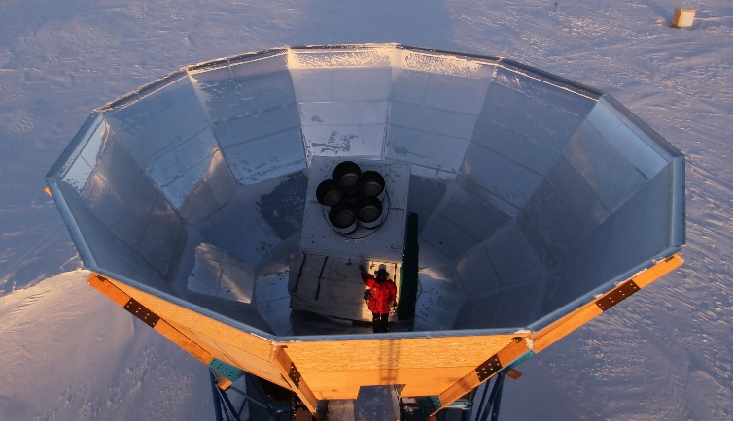
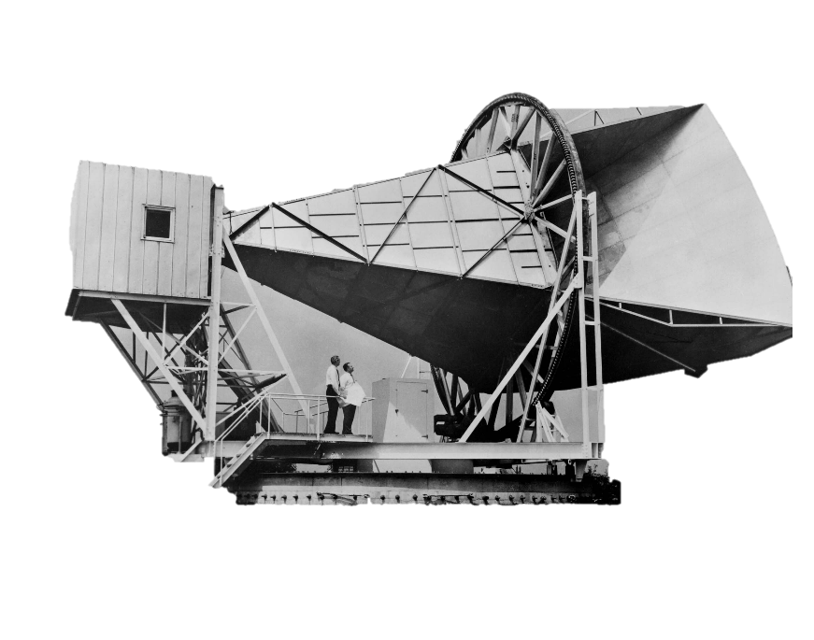
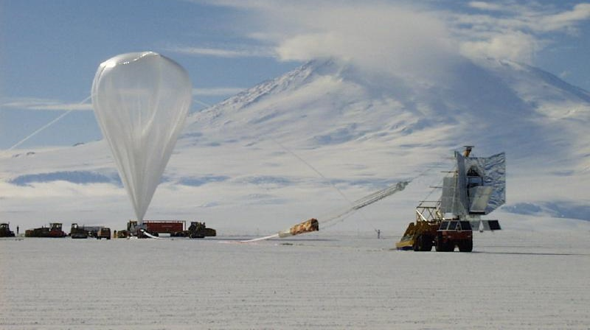
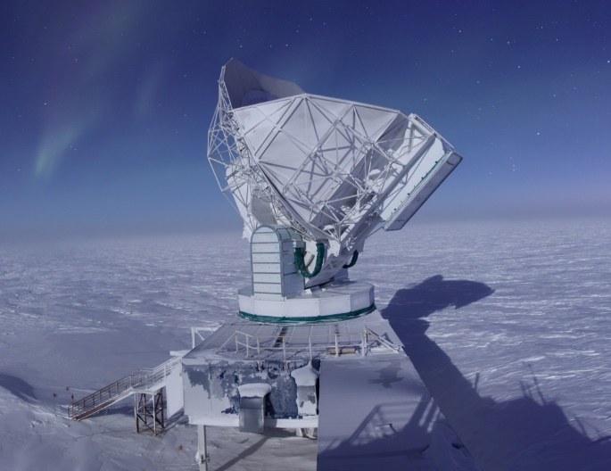
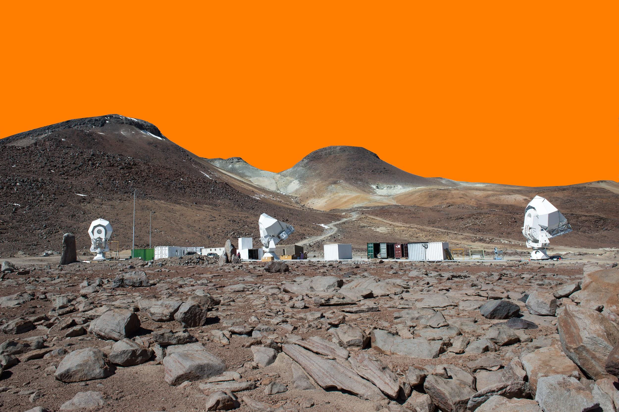
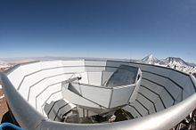
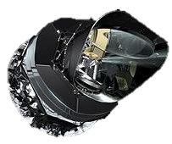
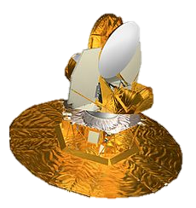
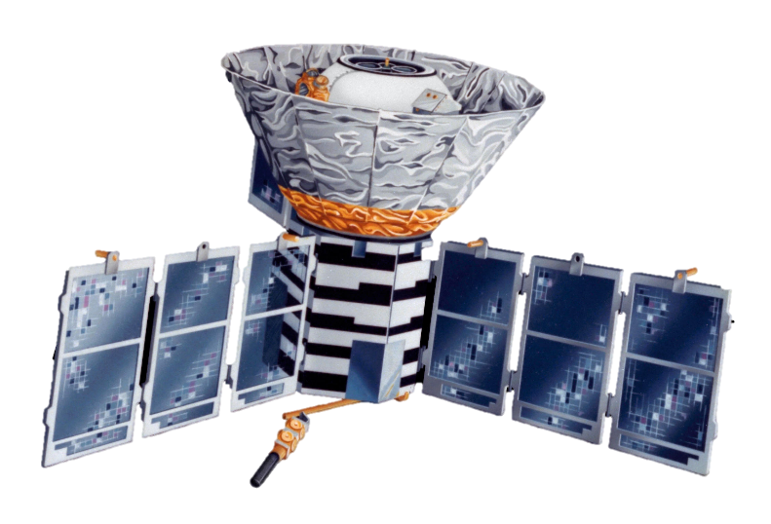
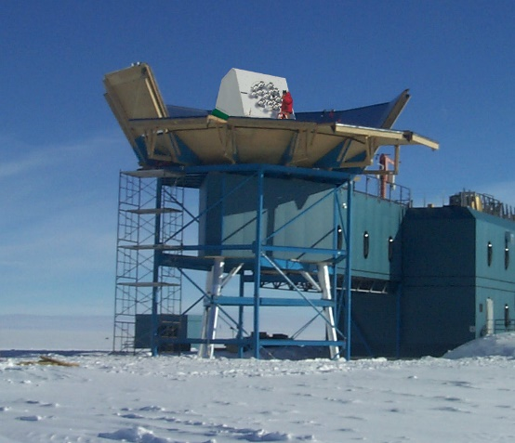
A quick CMB history
1965
Holmdel Horn Antenna, Discovery
1992
COBE, Primary anisotropy
2001
Toco/MAXIMA/Boomerang, acoustic peaks
2002
DASI/WMAP, E-mode polarization
2014
SPT/ACT/POLARBEAR/BICEP, lensed B-mode polarization
2015
Planck
Notes:
Flatness and horizon
Lambda CDM
the existence and structure of the cosmic microwave background
the large-scale structure in the distribution of galaxies
the observed abundances of hydrogen (including deuterium), helium, and lithium
the accelerating expansion of the universe observed in the light from distant galaxies and supernovae
The model includes a single originating event, the "Big Bang", which was not an explosion but the abrupt appearance of expanding space-time containing radiation at temperatures of around 10¹⁵ K. This was immediately (within 10⁻²⁹ seconds) followed by an exponential expansion of space by a scale multiplier of 10²⁷ or more, known as cosmic inflation.

Slide 4
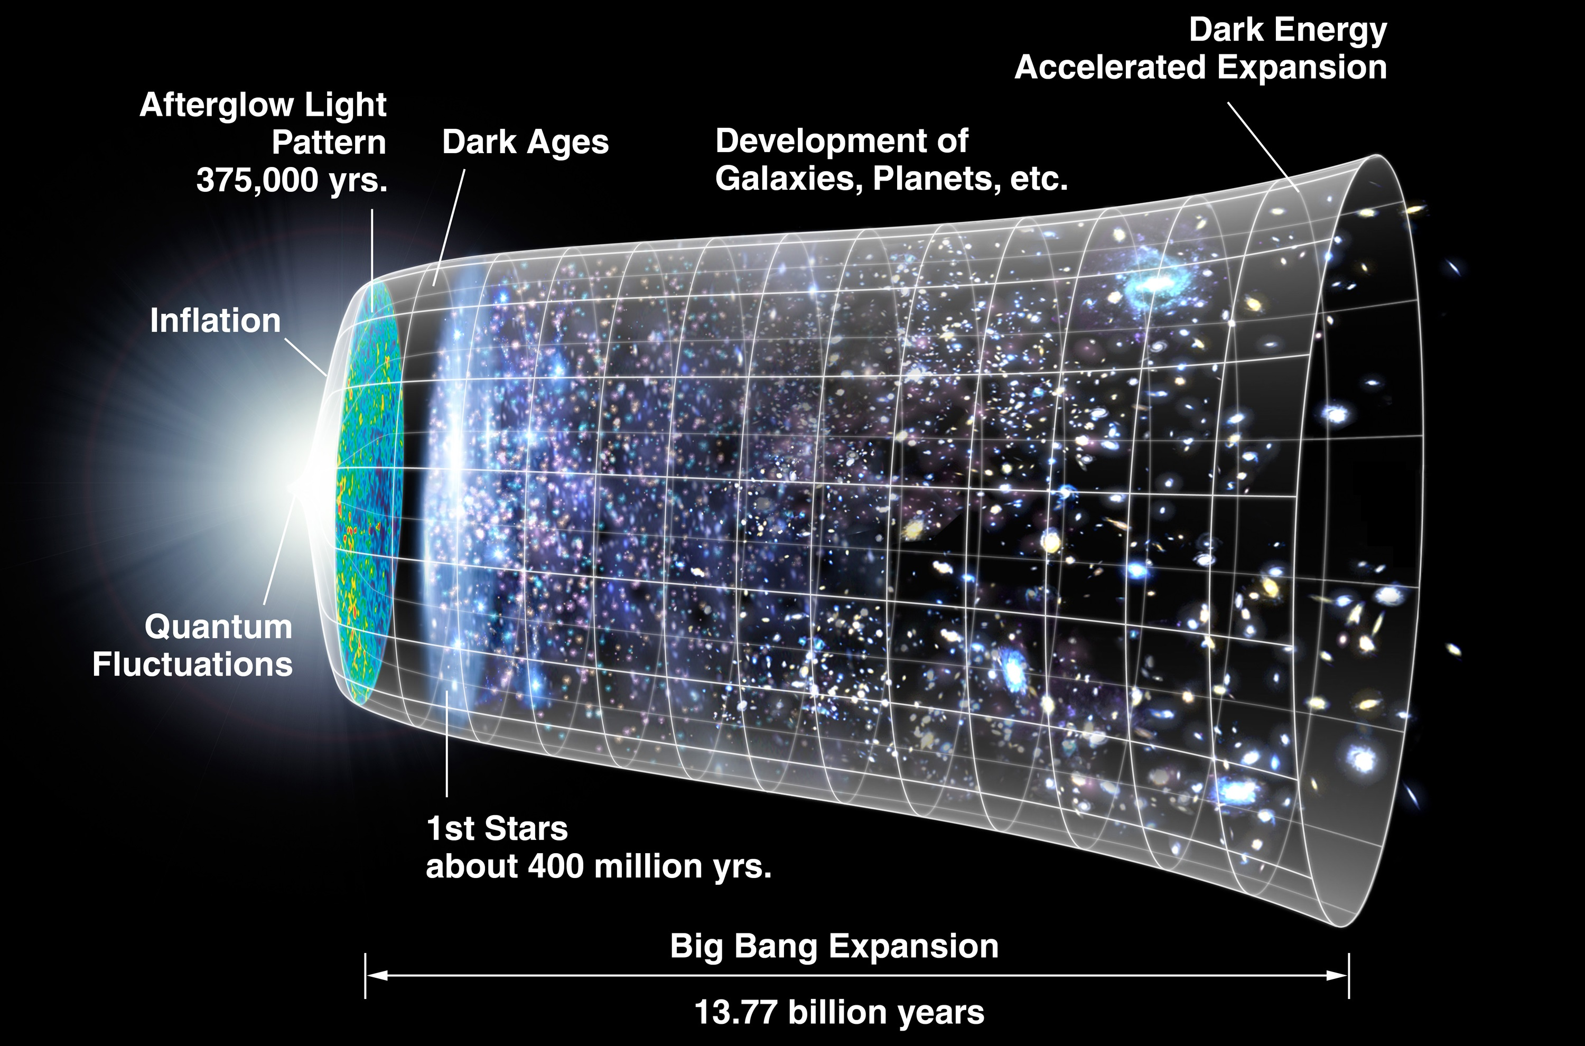

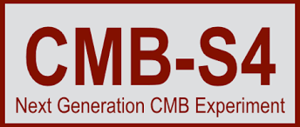
Cosmic History
NASA/WMAP

Slide 5
The sky with microwave eyes
T = 2.725 K
The Simons Array

Slide 6
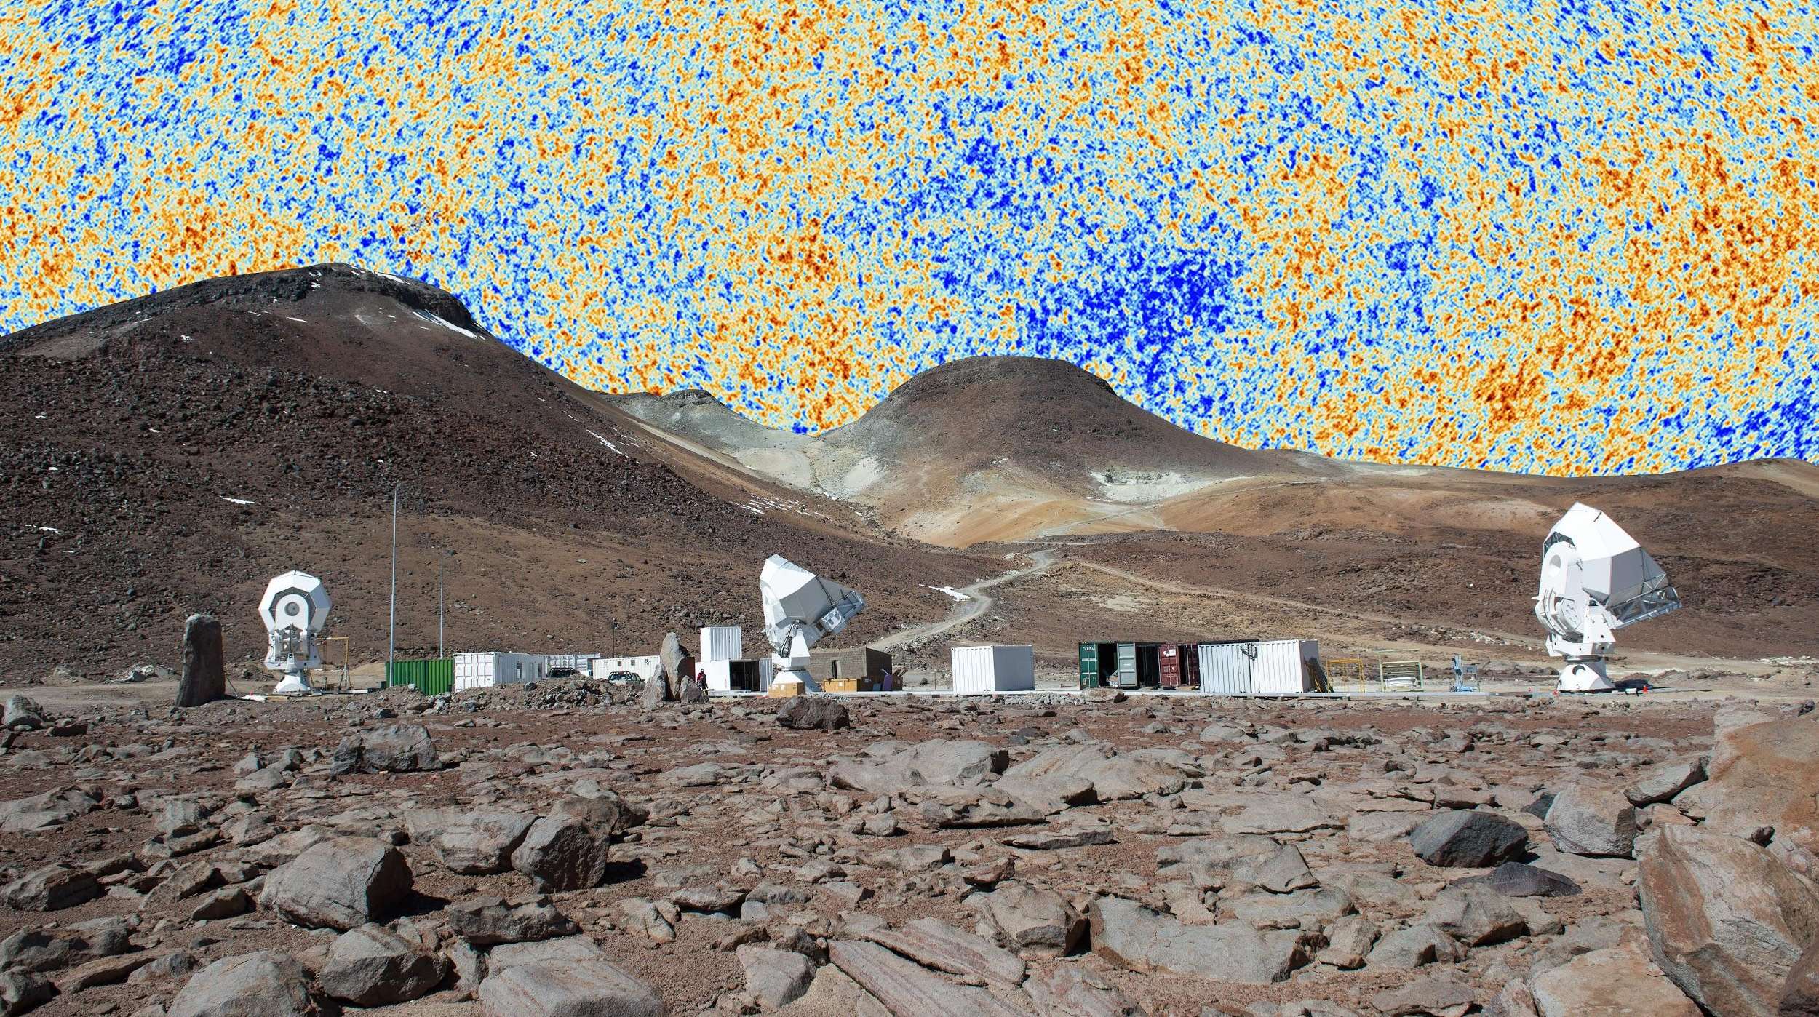
Temperature Fluctuations
ΔT = ± 300𝛍K
Image: Planck
The Simons Array

Slide 7
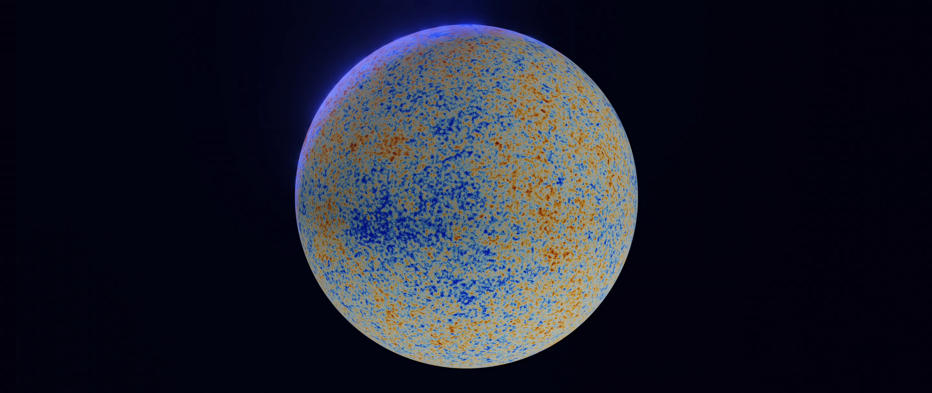
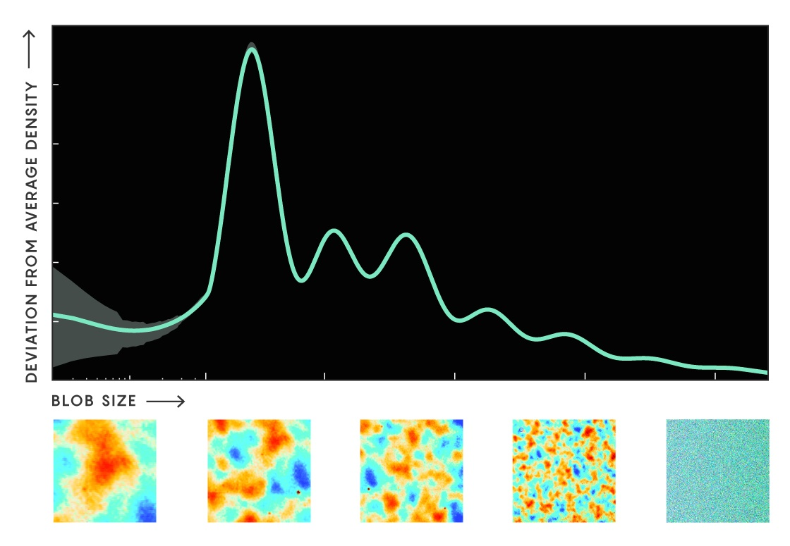
Spherical Harmonics
Lucy Reading-Ikkanda/Quanta Magazine; Planck 2013 XVI
Dillon Berger @InertialObservr

Slide 8
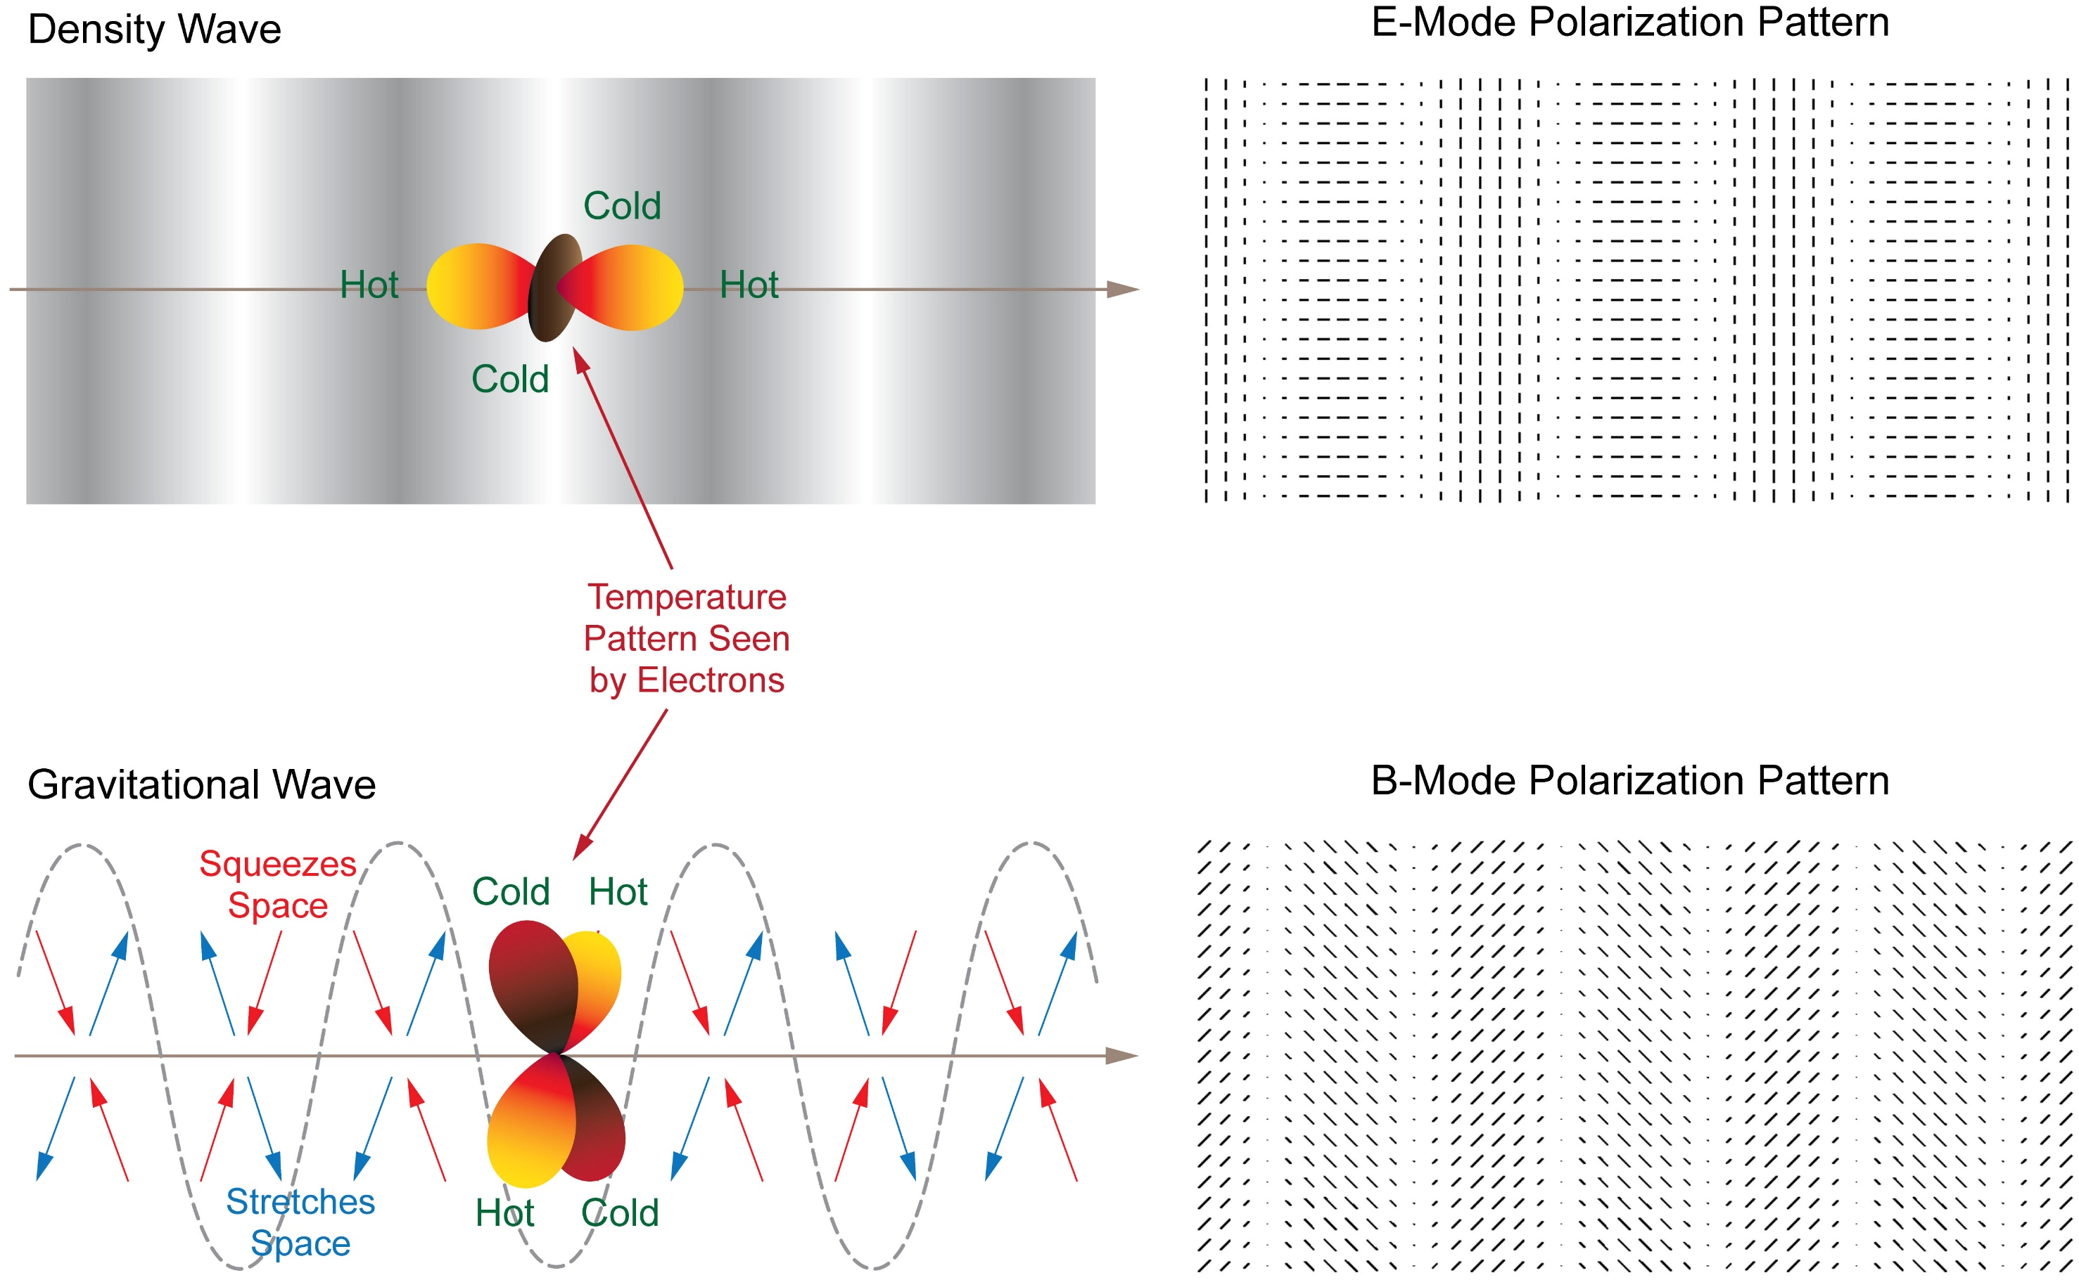
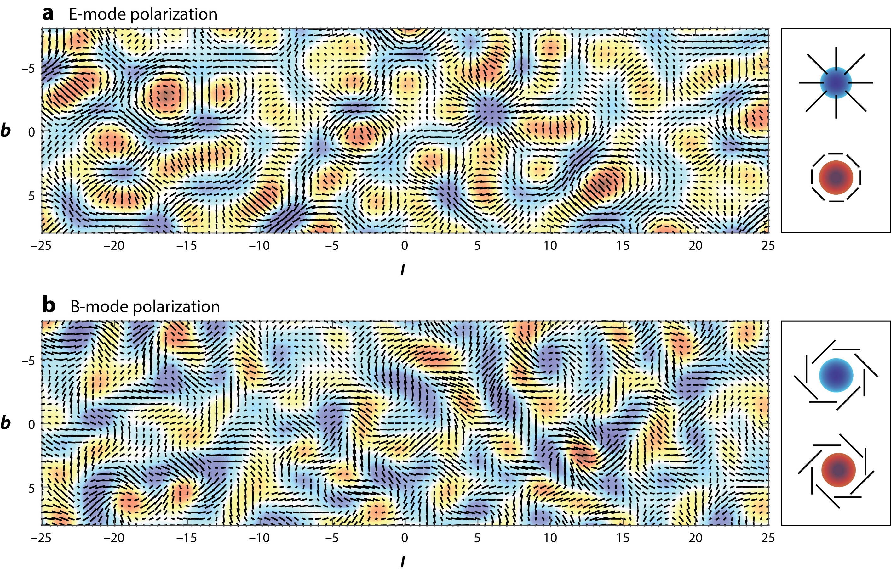
The Polarized CMB
Kamionkowski and Kovetz 2015
BICEP2 Collaboration
Notes:
detection of fluctuations in the metric/fabric of spacetime; in the context of inflation, detection of the energy scale of the process;
if inflation happened at such high energies, there are many other implications for models of particle physics.
E-mode polarization is generated by density perturbations
fluctuations in the metric also generate B-mode polarization
at the levels being targeted it would in fact imply a detection of fluctuations in the metric before the universe entered the usual hot big bang expansion,

Slide 9
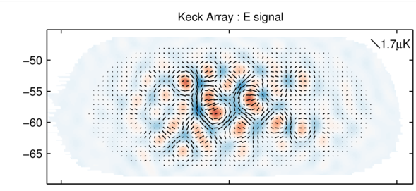
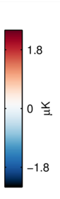
Detecting CMB E-modes
BK-V

Slide 10
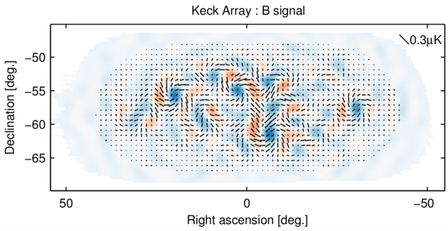
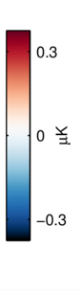



Detecting Primordial Gravitational Waves
BK-V
Kamionkowski and Kovetz 2015

Slide 11
Interpreting the Power Spectrum
Brief intro, more to come during workshop

Slide 12
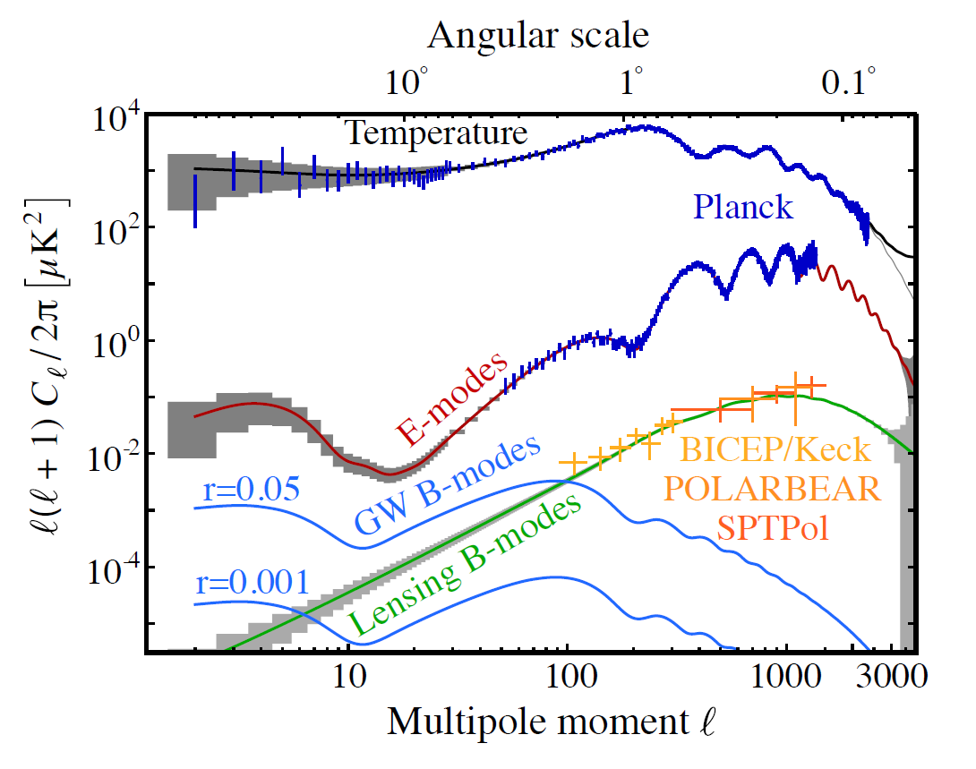
Amplitude vs. angular scale
BICEP
CMB-S4 Science Book

Slide 13
Amplitude vs. Frequency
Intensity (Jy/sr)
Frequency (GHz)
Adapted from
Kogut et al (2016)

Slide 14
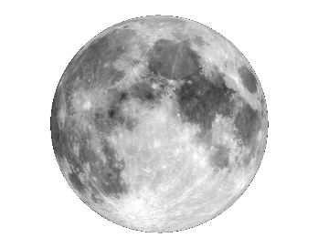
Component angular scale dependence
galactic dust + synchrotron 1% ➔ 90% of the sky @ 150GHz
gravitational
lensing
primordial BB
Josquin Errard
Notes:
These level of foregrounds are from CMB4cast (Errard, Feeney + 2015), where we interpolated results from Planck. The 1% roughly be what is observe on the BICEP patch (i.e. r ~ 0.2 at 150GHz).
Yes for the 90%, this is what we get when we remove the brightest 10% part of the galactic plane.
would help to say "r" level presented is adopted from Bicep/Keck limit -- the level of the scalar to tensor level can move up or down in this plot.

Slide 15
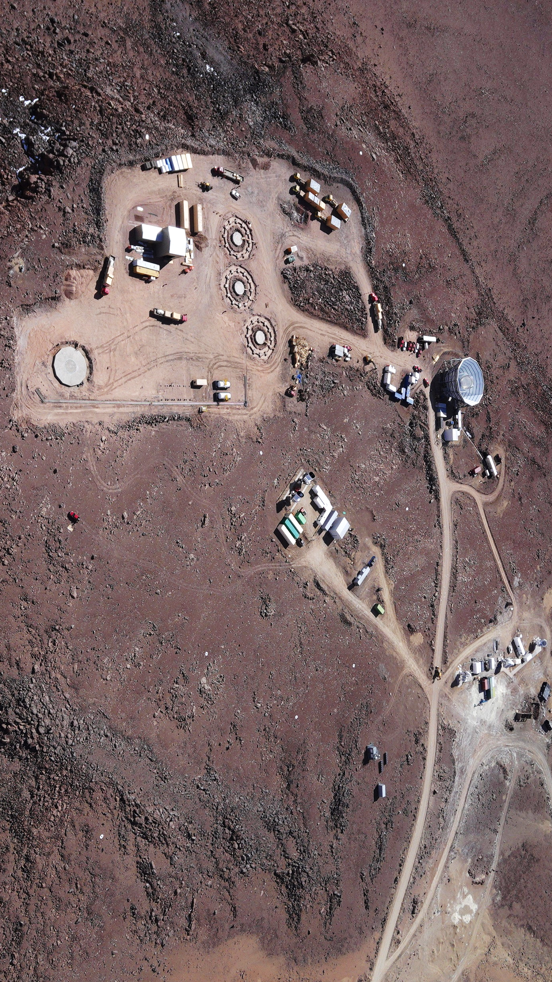

Observatory Site
ACT
Simons Array
CCAT-p
CLASS
SATs
ALMA
LAT

Slide 16
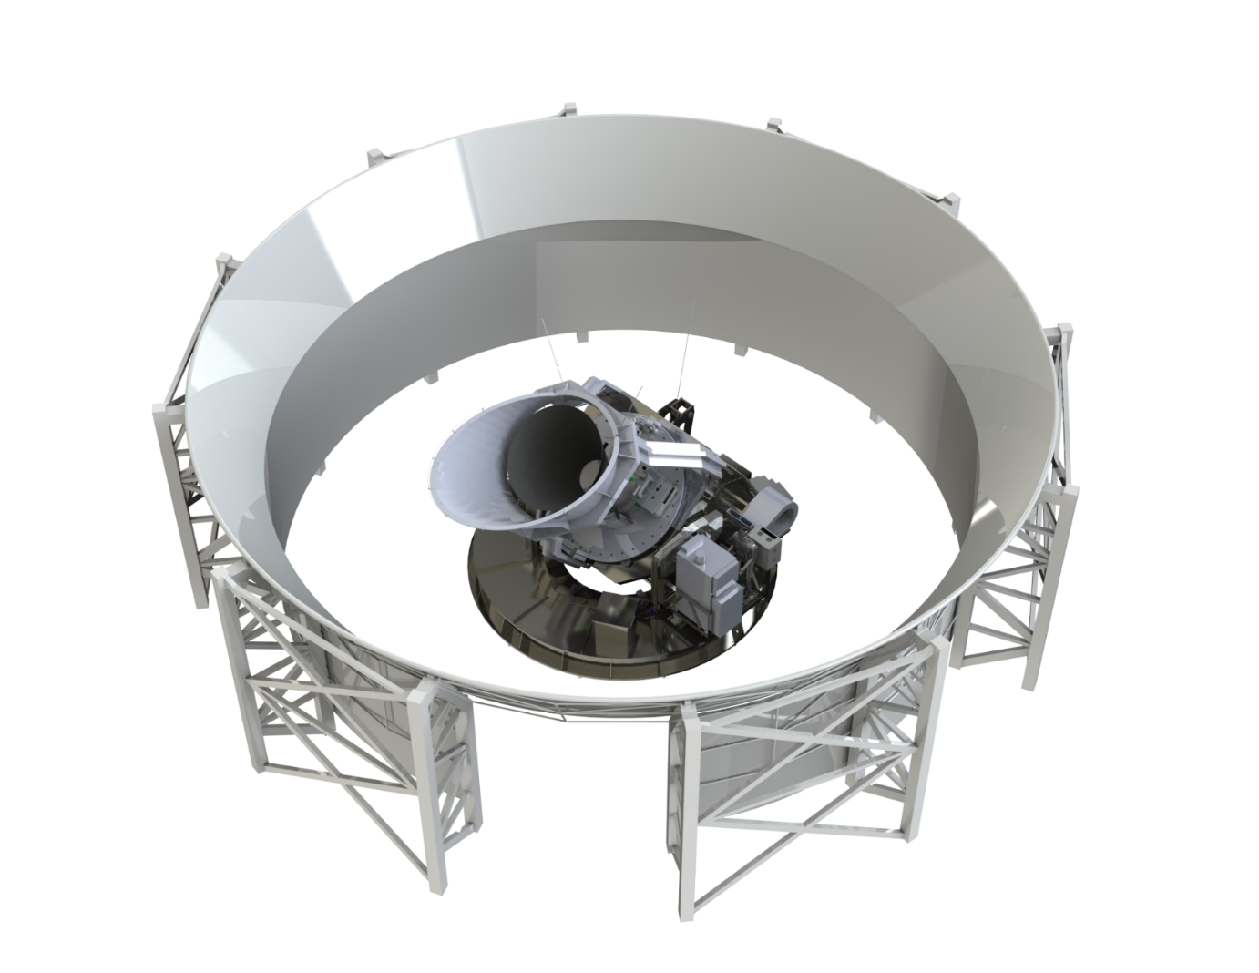
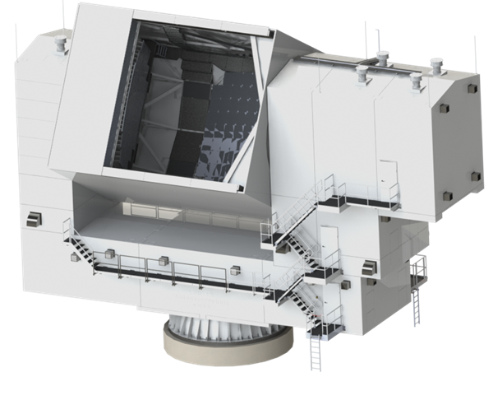
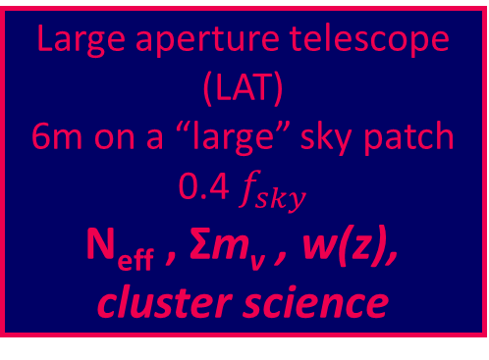
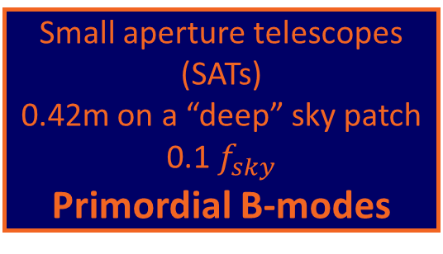
Two telescope designs
Small aperture telescopes (SATs)
0.42m on a “deep” sky patch
0.1 $f_{sky}$
Primordial B-modes
Large aperture telescope (LAT)
6m on a “large” sky patch 0.4 $f_{sky}$
N_{eff} , Σm_{v} , w(z), cluster science
Josquin Errard
Galitzki et al. 2018

Slide 17
Frequency channels
Simons Observatory
Intensity (Jy/sr)
27
39
93
225
145
280
Frequency (GHz)
Adapted from
Kogut et al (2016)

